Slide 1

GRADUATION PROJECT PRESENTATION
Real-Time Anomaly Detection
for IoT Sensor Streams
A scalable production-grade system leveraging Azure Event Hubs, Machine Learning, and MLOps for industrial infrastructure monitoring.

Slide 2


















PROJECT OVERVIEW & MOTIVATION
Securing Industrial Stability through Intelligent IoT Monitoring
Industrial Necessity
Core Motivation
Rapid growth of Smart Infrastructure and IoT-enabled manufacturing lines.
Risk Mitigation: Unplanned downtime costs industries millions in lost productivity.
Continuous generation of high-velocity sensor data (temperature, vibration, pressure).
Scalability: Moving beyond manual thresholds to automated, production-scale AI models.
Critical need to detect deviations from normal operating patterns immediately.
Real-Time Response: Triggering alerts and dashboard updates the moment an anomaly is detected.
DATA INGESTION
AI INFERENCE
ACTIONABLE INSIGHTS
Azure Event Hubs / Kafka
Real-Time Anomaly Detection
Alerts & Live Dashboards
IoT Anomaly Detection System
Graduation Project Presentation

Slide 3













PROBLEM FORMULATION
Technical Problem Statement & Key Challenges
Technical Problem Statement
Challenge: Identifying deviations in high-velocity IoT sensor streams where normal operational patterns are dynamic, multi-dimensional, and subject to environmental variations. Traditional threshold-based approaches fail to capture complex temporal dependencies and contextual anomalies in streaming data with sub-second latency requirements.
Data Noise
Concept Drift
Real-Time Requirements
Sensor measurement errors and environmental interference
Evolving operational patterns due to seasonal changes
Sub-second detection latency for critical systems
Network transmission artifacts and packet loss
Equipment aging and maintenance-induced shifts
Processing thousands of concurrent sensor streams
Distinguishing true anomalies from noise-induced variations
Model degradation without continuous adaptation
Memory-efficient algorithms for continuous operation
IoT Anomaly Detection System
Problem Formulation - Part 1

Slide 4





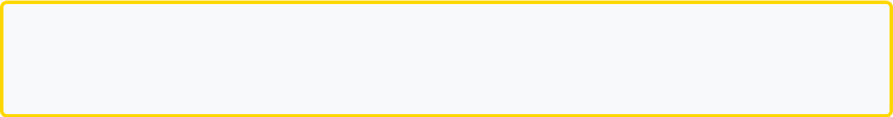
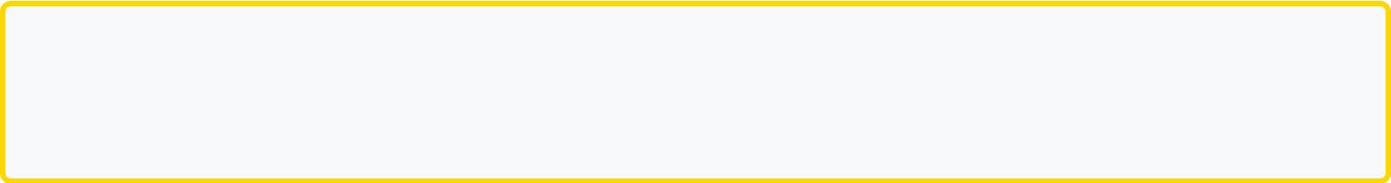








PROBLEM FORMULATION
Formal Objectives & Performance Metrics
Minimize False Alarms
High Detection Sensitivity
Goal: Achieve precision ≥ 85% to reduce operational disruption from false positives while maintaining system reliability.
Goal: Maintain recall ≥ 90% to ensure critical anomalies are not missed, preventing system failures.
Precision = TP / (TP + FP)
Target: P ≥ 0.85
Recall = TP / (TP + FN)
Target: R ≥ 0.90
Low System Latency
< 500ms
< 100ms
99.9%
End-to-End Detection
Model Inference
System Availability
Data ingestion to alert
Per sensor reading
Continuous operation
Optimization Objective
Maximize F1-Score while constraining latency:
F1 = 2 × (Precision × Recall) / (Precision + Recall)
Subject to: Latency ≤ 500ms, Availability ≥ 99.9%
IoT Anomaly Detection System
Problem Formulation - Part 2

Slide 5












Core Project Objectives
Defined goals for the IoT Anomaly Detection System
Real-Time Detection
Production Scalability
Develop low-latency algorithms to identify anomalies in streaming IoT data as they occur, minimizing response time.
Engineer a system capable of scaling across thousands of sensor streams using high-throughput cloud infrastructure.
Automated Alerting
Live Dashboards
Implement automated notification workflows via Azure Monitor and Logic Apps to trigger immediate operational reactions.
Provide stakeholders with real-time visibility through dynamic Power BI or Grafana dashboards for continuous oversight.
MISSION CRITICAL SYSTEM

Slide 6






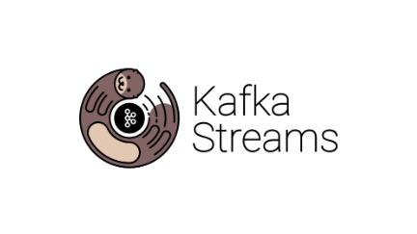
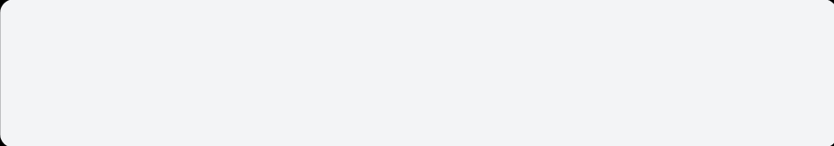






PROJECT MILESTONES
Milestone 1: Data Collection & Ingestion
1. Data Sources
2. Ingestion Layer
3. Raw Storage
Ingestion of multi-source time-series streams from industrial sensors and smart infrastructure.
Persistent storage of raw telemetry data for long-term analysis and historical retraining.
Temperature & Vibration
AZURE EVENT HUBS
TARGET DESTINATION:
Pressure & Flow Rates
APACHE KAFKA
Azure Data Lake Gen2 / Blob Storage
DELIVERABLES
Processed Dataset
Preprocessing Pipeline Doc
EDA Patterns Report

Slide 7










DATA PREPROCESSING & CLEANING
Milestone 1: Transforming Raw Streams into Model-Ready Features
1
CLEANING
2
3
STRUCTURE
ENGINEERING
Noise & Missing Data
Windowing Strategy
Feature Extraction
Smoothing: Moving average filters to remove high-frequency sensor jitter.
Sliding Windows: Capturing temporal dependencies across sensor events.
Statistical: Mean, variance, and RMS calculated per window.
Imputation: Forward-fill and linear interpolation for missing sensor packets.
Segmentation: Fixed-length intervals for real-time inference compatibility.
Temporal: Rate of change and cross-correlation between streams.
Cleaned
KEY DELIVERABLE
Optimized
Processed Time-Series Dataset
INPUT STREAMS
FEATURE MATRIX

Slide 8






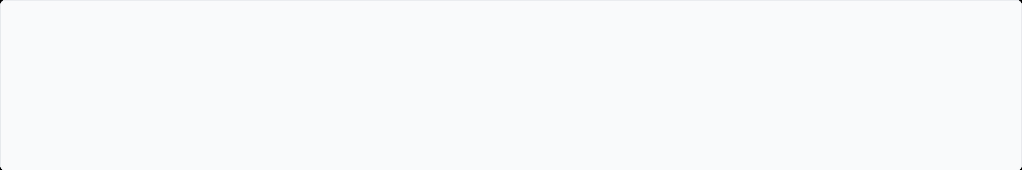




Exploratory Data Analysis (EDA)
MILESTONE 1: TASK 3
Statistical Patterns
Correlation Analysis
Establishing baseline behaviors for multi-source IoT streams to distinguish normal operation from noise.
Mapping inter-sensor dependencies to understand how failures propagate through the system.
Mean, Variance, and Kurtosis profiling
Inter-feature dependency mapping
Seasonality and Trend decomposition
Lagged correlation for stream synchronization
Distribution analysis per sensor type
Redundancy detection in sensor data
IDENTIFYING ANOMALY PATTERNS
Point Anomalies
Contextual
Collective
SPIKES & OUTLIERS
ENVIRONMENT-BASED
SEQUENCE-BASED
"Defining what 'abnormal' looks like across time-series windows to inform model selection."
Sudden value deviations exceeding statistical thresholds.
Normal values that are abnormal in specific time windows.
A group of data points indicating a gradual system failure.
DELIVERABLE:
Anomaly Patterns EDA Report

Slide 9











MILESTONE 2: MODELING & EVALUATION
Model Selection Strategy
The objective is to evaluate unsupervised and semi-supervised approaches capable of detecting deviations in high-frequency IoT sensor streams.
Autoencoders
Isolation Forests
LSTM-Based
APPROACH
APPROACH
APPROACH
Neural networks trained to compress and reconstruct normal data patterns.
Tree-based ensemble that isolates observations by randomly selecting features.
Recurrent Neural Networks designed to learn long-term temporal dependencies.
High reconstruction error = Anomaly
Efficient for high-dimensional data
Ideal for time-series sequences
Captures non-linear relationships
Faster inference for real-time streams
Detects patterns across time windows
PRECISION-RECALL
INFERENCE LATENCY
Target: Real-Time Detection Simulation
MEMORY FOOTPRINT

Slide 10













Model Training and Optimization
SYSTEMATIC OPTIMIZATION WORKFLOW
1. Data Feeding
2. Model Training
3. Performance Eval
4. Hyperparameter Search
Windowed & Smoothed Streams
Autoencoders / Isolation Forest
Precision & Recall Analysis
Grid & Random Search Tuning
Autoencoders
Isolation Forest
LSTM-Based
•
Optimizing latent space dimensions.
•
Adjusting contamination ratio parameter.
•
Sequence window size optimization.
•
Tuning reconstruction error thresholds.
•
Optimizing number of estimators (trees).
•
Learning rate scheduling (Adam/RMSprop).
•
Weight decay and dropout regularization.
•
Max samples per tree for speed/accuracy.
•
Hidden layer and cell count tuning.
SIMULATION
MLOps Integration Ready
Real-time detection simulation was used to validate optimized hyperparameters under production load.

Slide 11











Performance Evaluation Metrics
CORE CLASSIFICATION METRICS
PRODUCTION VALIDATION
Precision
Real-Time Detection Simulation
Focus on minimizing False Positives. Crucial for reducing alert fatigue in operations teams.
Beyond static metrics, the model is evaluated using a streaming simulation environment to mimic live IoT data flow.
DETECTION LATENCY
THROUGHPUT
Recall
Sub-second response
10k+ events / sec
Focus on minimizing False Negatives. Critical to ensure no system failure goes undetected.
Goal: Production Readiness
Validating the model's ability to operate under heavy load with high reliability.
Project Milestone 2: Evaluation Phase

Slide 12









MILESTONE 3
Cloud Deployment Architecture
Transitioning from model development to a production-ready inference pipeline on Azure, designed for high-throughput IoT telemetry and low-latency anomaly detection.
1. Data Ingestion
2. Stream Analytics
3. Azure Functions
4. Integration
Azure Event Hubs
Real-time Filtering
Triggered Inference
Logic Apps Alerts
Kafka Integration
Windowing Functions
Containerized Models
Azure Monitor
REST API Entrypoint
Stream Aggregation
ML Service Integration
Data Lake Storage
Scalability
Efficiency
ELASTIC HANDLING OF SENSOR VOLUME
SERVERLESS LOW-COST INFERENCE

Slide 13











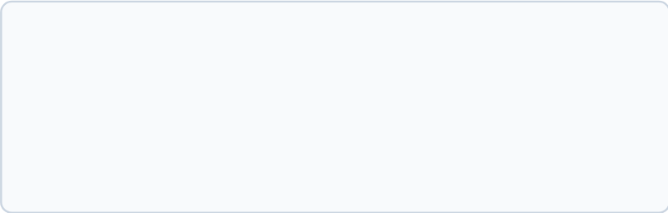
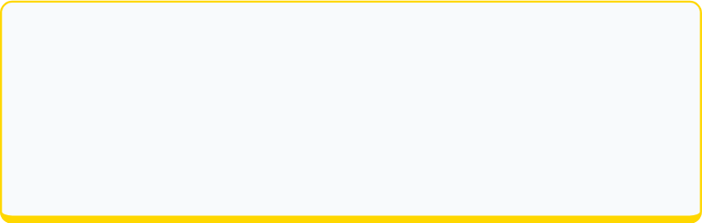
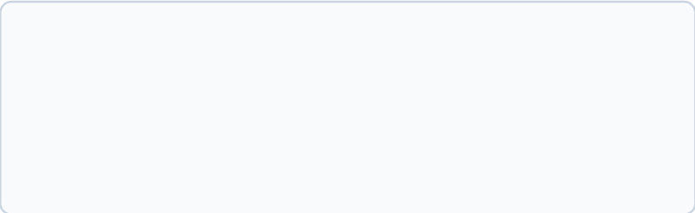
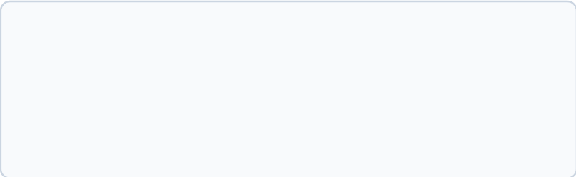




MODEL CONTAINERIZATION & REST API
Milestone 3: Deployment & Production Integration
Containerization Strategy
Scalable REST Service
Docker Implementation:
Inference Endpoints:
Packaging trained models (Autoencoders/LSTMs) with dependencies for environment parity.
Exposing high-performance endpoints for real-time sensor stream ingestion.
Azure Integration:
Low-Latency Processing:
Leveraging Azure ML for managed container orchestration and scaling.
Optimized request handling to ensure sub-second anomaly detection.
Portability:
Authentication:
Consistent execution across dev, staging, and production environments.
Secure access via Azure Monitor and API keys for IoT gateway integration.
REAL-TIME INFERENCE WORKFLOW
IOT SENSOR
REST API
CONTAINER
ALERT SYSTEM
Stream Generation
Data Ingestion
Model Inference
Response Trigger

Slide 14















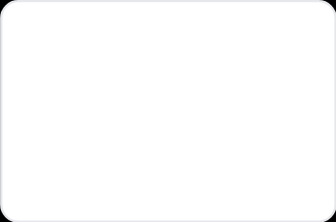




Integrated Alerting System
Closing the Loop: From Detection to Action
Cloud-Native Integration
Leveraging the Azure ecosystem to transform raw anomaly scores into actionable business intelligence.
1
ANOMALY DETECTION
Azure Stream Analytics identifies outliers in the 10ms-window sensor data.
Zero-latency metric ingestion
2
AZURE MONITOR
Custom threshold logic
Metrics are evaluated against dynamic thresholds. Triggers high-priority alerts.
Multi-channel notification support
3
AZURE LOGIC APPS
Orchestrates notifications via Email, SMS, or custom Webhooks to maintenance teams.
4
DASHBOARD UPDATE
Real-time Power BI or Grafana flags the anomalous sensor on the factory floor map.
Email Alerts
SMS Notifications
Webhook Integrations
Milestone 3: Cloud Deployment & Integration

Slide 15
















MILESTONE 4
MLOps & Experiment Tracking
Implementing MLflow as the backbone for managing the machine learning lifecycle, ensuring every anomaly detection model is reproducible, versioned, and production-ready.
Experiment Tracking
Model Registry
Lifecycle Management
• Logging hyperparameters (learning rate, window size)
• Centralized version control for ML models
• Standardized environment (Conda/Docker)
• Stage transitions (Staging → Production)
• Full lineage from data to deployment
• Capturing metrics (Precision, Recall, F1-Score)
• Collaborative model auditing and reviews
• Automated documentation of training runs
• Storing artifacts (serialized model files)
THE MLFLOW INTEGRATION PIPELINE
Data Stream
Tracking Server
Model Registry
Production API

Slide 16





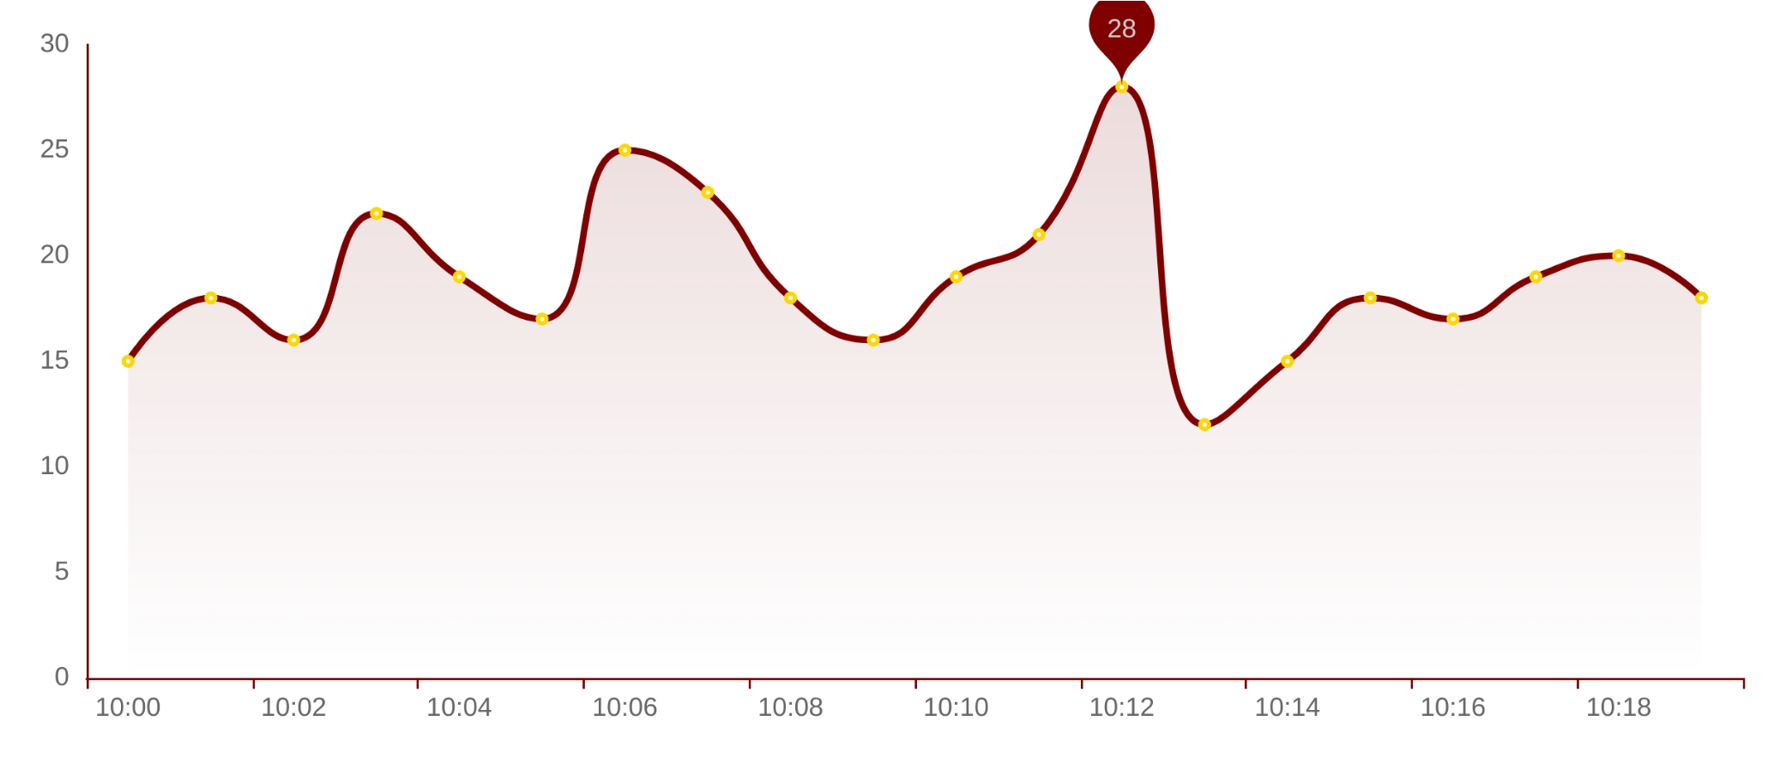










Real-Time Monitoring Dashboard
Visualization Stack
LIVE SENSOR STREAM: VIBRATION_01
STATUS: NORMAL
Grafana for live telemetry
Power BI for historical analysis
InfluxDB / Azure Data Explorer
Dashboard Features
Live Anomaly Status
Multi-sensor Correlation
Alert History & Severity
ACTIVE SENSORS
ANOMALIES (24H)
LATENCY
128
12
45ms
MILESTONE 4: MLOPS & MONITORING

Slide 17










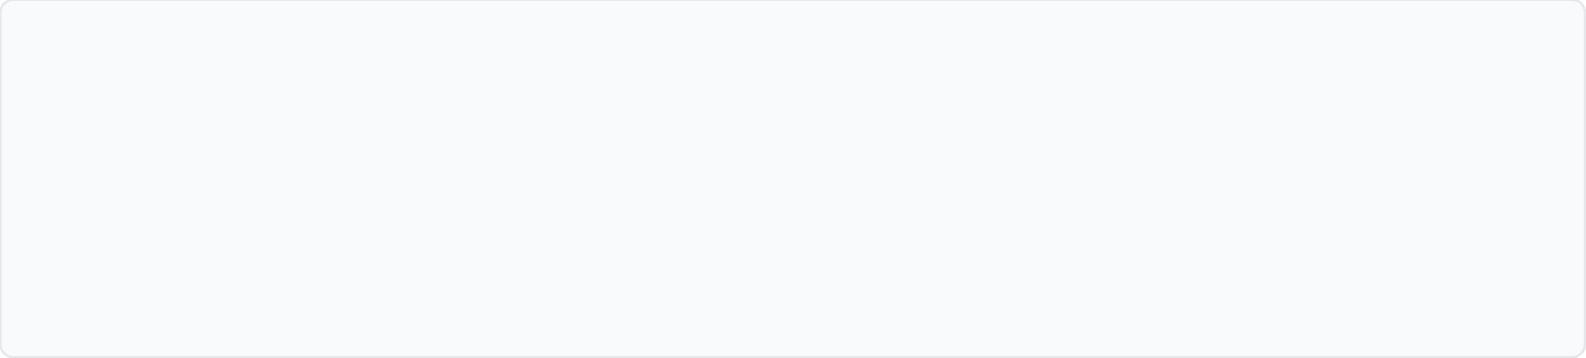


Automated Retraining Pipeline
1. Drift Detection
2. Trigger Logic
3. Auto-Retrain
4. Deployment
Continuous monitoring of input feature distributions and prediction confidence.
Automated alerts via Azure Monitor when drift metrics exceed thresholds.
Orchestrated MLflow pipeline fetches new data and re-optimizes parameters.
Shadow deployment and performance validation before production swap.
Retraining Trigger Mechanism
DATA DRIFT
Statistical change in sensor input distributions (PSI, Temp, Vibration).
PIPELINE INTEGRATION
Azure Machine Learning Pipelines
CONCEPT DRIFT
Degradation in model precision/recall against ground truth labels.
MLflow Experiment Tracking
Automated Model Versioning
MILESTONE 4: MLOPS & MONITORING

Slide 18














Milestone 5
| Final Documentation Overview
Data & Preprocessing
Modeling & Evaluation
Preprocessing Pipeline Documentation
Model Evaluation & Metrics Report
Anomaly Patterns EDA Report
Hyperparameter Optimization Log
Cloud & MLOps
Final Deliverables
MLOps Pipeline Documentation
Full Project Final Report
Azure Deployment & API Specs
Future Enhancements Proposal
DOCUMENTATION STATUS
100%
End-to-End
Comprehensive Project Knowledge Base Complete
COMPLETE
TRACEABILITY

Slide 19









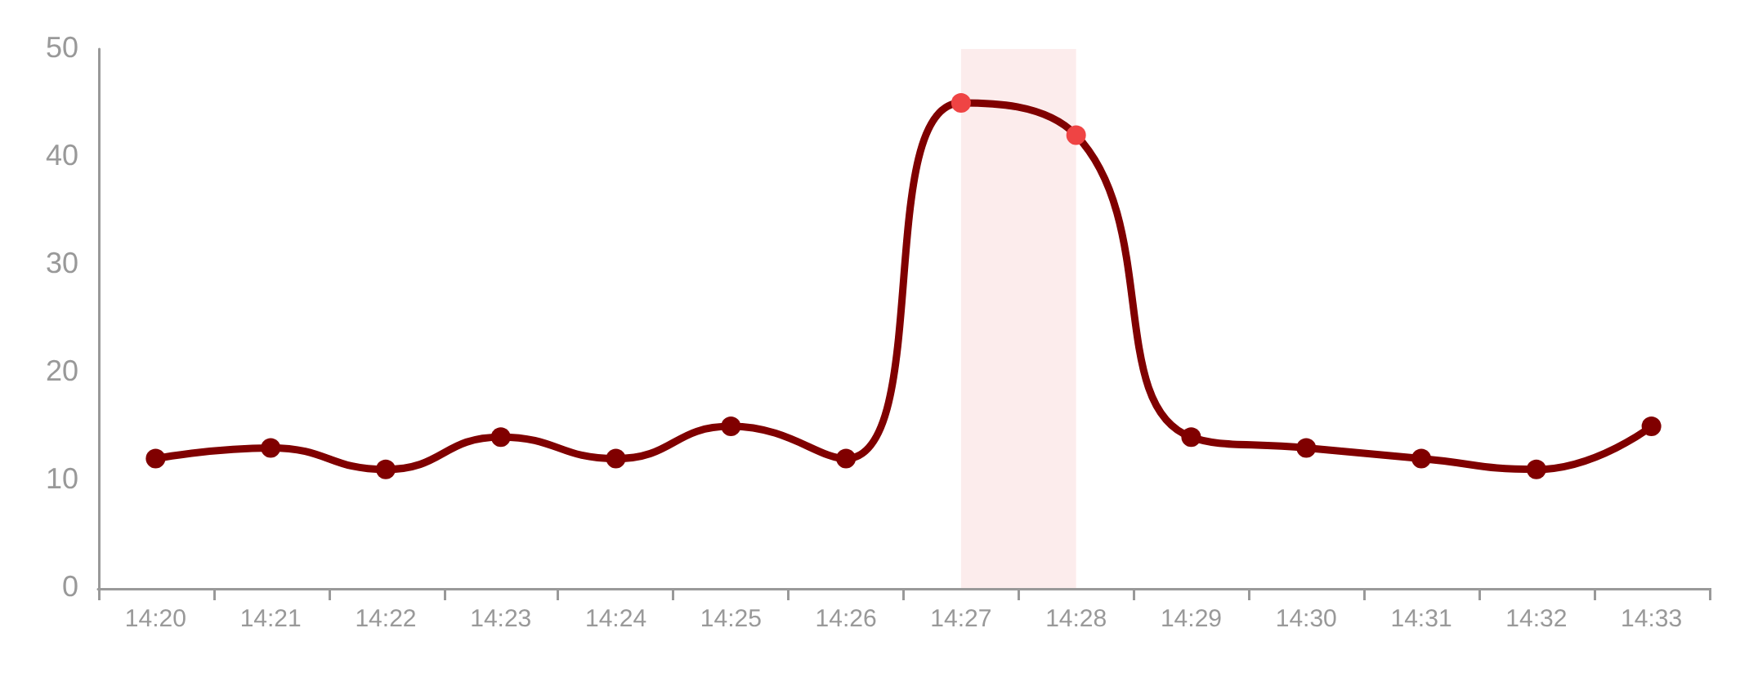




End-to-End System Demonstration
Live walkthrough of the integrated data pipeline and real-time response.
STAGE 01
STAGE 02
STAGE 03
STAGE 04
Data Ingestion
Stream Processing
ML Inference
Alert & Dashboard
Azure Event Hubs captures raw sensor streams.
Stream Analytics applies windowing & smoothing.
Containerized model detects anomalies.
Logic Apps triggers alerts; Power BI updates.
LIVE ANOMALY DETECTION STREAM
SYSTEM ACTIVE
TRIGGERED ALERTS
14:22:05 — Warning
Vibration Spike Detected
14:25:12 — CRITICAL
Anomalous Temperature Trend
14:28:44 — Info
System Self-Correction Initiated
OPEN FULL DASHBOARD

Slide 20









FUTURE ENHANCEMENTS PROPOSAL
Strategic roadmap for scaling the system to enterprise-level data volumes and integrating state-of-the-art AI architectures.
System Scaling
Advanced Models
Intelligent MLOps
Edge AI Integration: Deploy models to IoT Edge devices to reduce latency and bandwidth usage.
Transformers: Utilize self-attention mechanisms for better long-term temporal dependencies.
Explainable AI (XAI): Implement SHAP/LIME to provide root-cause reasons for every detected anomaly.
Multi-Region Clusters: Implement Geo-distributed Azure Stream Analytics for global scale.
Graph Neural Nets (GNN): Model spatial relationships between sensors in complex machinery.
Self-Healing Pipelines: Automate recovery from sensor failures and data drift.
Cold Path Expansion: Integrate Azure Synapse for massive historical data trend analysis.
Federated Learning: Train models across decentralized devices while maintaining data privacy.
Digital Twins: Synchronize real-time anomaly data with 3D virtual models of infrastructure.
Vision 2025: Towards Autonomous Infrastructure Monitoring
SCALABILITY
INTELLIGENCE
AUTOMATION

Slide 21













CONCLUSION & KEY TAKEAWAYS
Project Achievements in Industrial IoT Anomaly Detection
Real-Time Intelligence
Cloud-Native Scalability
Successfully implemented a low-latency pipeline capable of processing multi-source IoT streams and detecting anomalies within milliseconds using optimized LSTM and Isolation Forest models.
The Azure-based architecture (Event Hubs + Stream Analytics) ensures the system can scale horizontally to handle thousands of concurrent sensors without performance degradation.
Operational Impact
Long-Term Reliability
Integrated alerting via Logic Apps and live Grafana dashboards provide stakeholders with immediate visibility, reducing potential downtime through proactive intervention.
Full MLOps integration with MLflow and automated retraining pipelines ensures the model remains accurate over time, accounting for data drift in dynamic industrial environments.
"A production-ready solution bridging the gap between raw sensor data and actionable industrial insights."
GRADUATION PROJECT FINAL CONCLUSION

Slide 22




Q&A and References
Key References & Documentation
Azure Architecture Center (2023)
"Real-time anomaly detection for streaming data on Azure." Microsoft Documentation.
Chandola, V., Banerjee, A., & Kumar, V. (2009)
"Anomaly detection: A survey." ACM Computing Surveys (CSUR).
Thank You!
Liu, F. T., Ting, K. M., & Zhou, Z. H. (2008)
"Isolation Forest." Eighth IEEE International Conference on Data Mining.
Any Questions?
MLflow Documentation
"Tracking and Managing the Machine Learning Lifecycle." mlflow.org
Apache Kafka & Event Hubs Guide
"Distributed Streaming Platforms for IoT." Technical Whitepaper.
IOT REAL-TIME ANOMALY DETECTION PROJECT | 2024

